Slide 1

Resources, Capabilities, and Strategies for Data Science Learners
2018 CSUN DataJam
CSU Northridge
Friday, September 28, 2018
Wayne Smith, Ph.D.
Department of Management
CSU Northridge
ws@csun.edu
This presentation is available at (.odp, .pptx, .pdf):
https://github.com/wsphd/datajam2018

Slide 2
Overview
Thinking as a Data Scientist
Positioning Yourself in the Contemporary Paradigm
Learning as a Data Scientist
What the Best Autodidacts (self-learners) Know
Acting as a Data Scientist
Earning Career Success
Q&A
Give away some goodies…

Slide 3
Motivating Question
Are you a data science learner?
…quantitative reasoning…
…big data…
…statistical computing…
…applied math…
…business intelligence…
…predictive analytics…
…decision support modeling…
…artificial intelligence…

Slide 4
Information Dynamics
Wisdom
Extraordinary Insight (Explanation) for Foresight (Prediction)
Restaurant: How should our menu change in the future to best optimize nightly sales?
Knowledge
Combination of Explicit Information and Tacit Information
Restaurant: What action led to the change in last night’s sales?
Information
Meaningful Data
Restaurant: How does last night’s sales compare to that night the previous year? How does last night’s sales compare to our goals?
Data
Raw, atomic, basic
Restaurant: What were the total sales for last night?

Slide 5
Analytics for Decision-making
Prescriptive Analytics
What should we do?
HR Department: What should we (the HR Department) do to meet or exceed the organization’s hiring and retention goals for next year? What data/information/knowledge/wisdom should we provide to our hiring and technical managers to help? What are we missing?
Predictive Analytics
What is likely to happen?
HR Department: How many new employees will our organization need next year? How will the mix change? What is our competition likely to do?
Diagnostic Analytics
Why did it happen?
HR Department: Did our emphasis on recruiting from campus A (over campus B, etc.) matter? What do the managers of these entry-level employees think?
Descriptive Analytics
What happened?
HR Department: How many entry-level professionals did we hire last year? How many of them are still with us now?

Slide 6
Persistent Tensions
Analytics
Automation
Explanation
Prediction
Desktop
Cloud
Base R
Tidyverse
SQL
Spark
Equation
Algorithm
Hypothesis-driven
Discovery-driven
Bias
Variance
Precision/Recall
Specificity/Accuracy
p-value
fit
Frequentist
Bayesian

Slide 7
What is Data Science?
Data Science is “the science of planning for, acquisition, management, analysis of, and inference from data.”
Data science is case-based, hands-on, and interdisciplinary.
Building upon experimentation, modeling, and computation, there are some that believe that data science is, in fact, a new, type of scientific discovery.
Data scientists demonstrate mastery of skills and concepts, including many traditionally associated with the fields of Mathematics, Statistics, and Computer Science and. Data Science blends much of the pedagogical content from all three disciplines, but it is neither the simple intersection, nor the superset of the three.
There is a fourth area of demonstrated mastery too: Subject-Domain expertise.

Slide 8
Math/Stat/CompSci/Subject Domain
What can we leverage well for data science success?
…Language
…Approach
…Operational Scale
…Validity
Evidence-
Based…
Equations, Theorems
Parametric tests, Regressions
Algorithms, Literate Programming
Various—Professional Standards
Practice
Probability, Matrices
General Linear Model
Computa-tional Thinking
Various—Research-based
Theory
Math
Statistics
Computer Science
Subject Matter (Domain)
Discipline

Slide 9
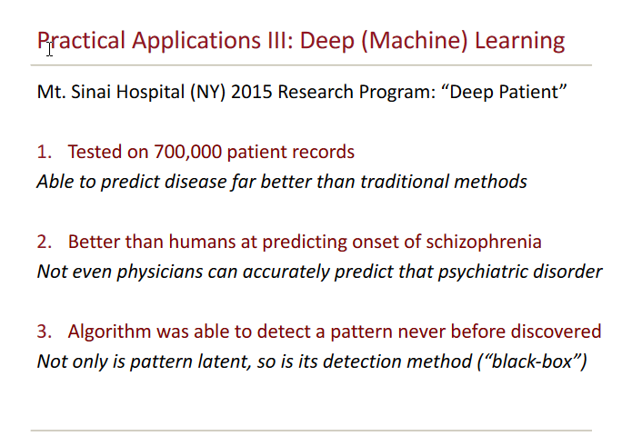

Slide 10
Balance Breadth and Depth
R
Python
Julia
Visualization
t-test for two independent groups, OLS linear regression, k-means clustering (or classification)
LP/convex optimization, GIS/spatial analysis, network analysis, text analysis
computational thinking
CranViews
https://cran.r-project.org/web/views/

Slide 11
Math/Stat/CompSci/Subject Domain w/ Theory and Practice
What can we leverage well for data science success?
Math
Stat
CompSci
computational thinking

Slide 12
Commercial Packages too

Slide 13
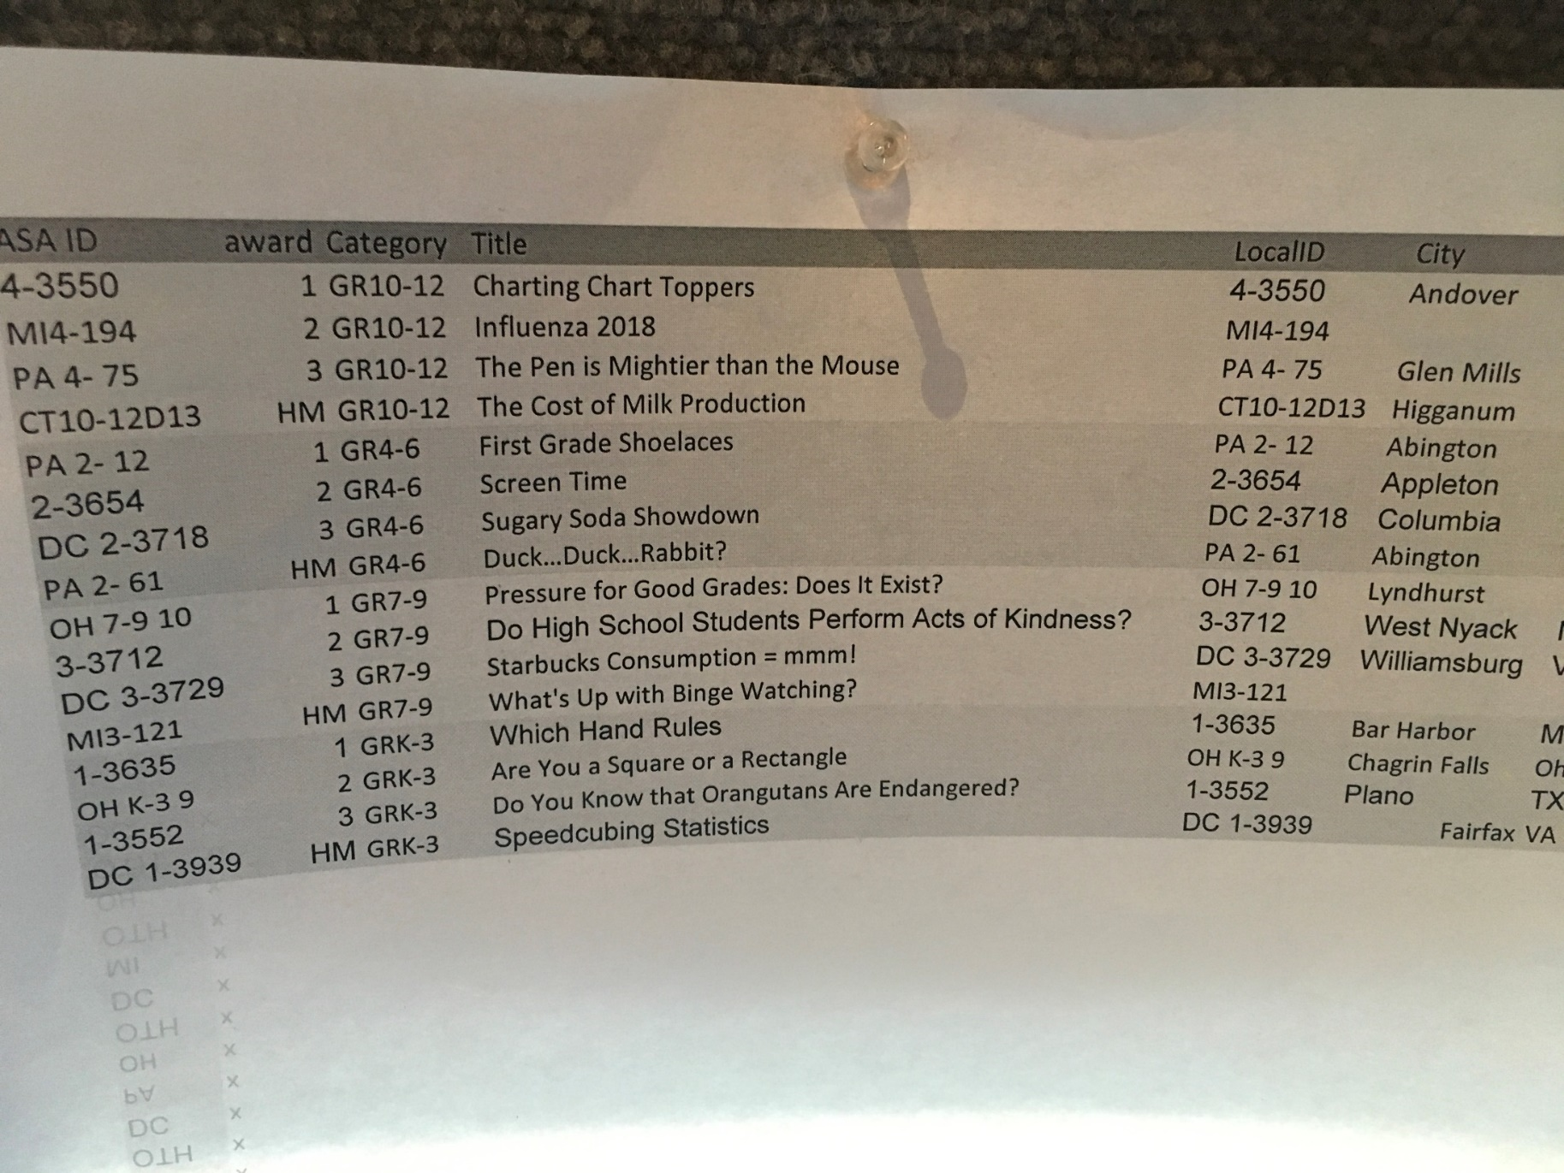
Common Core (e.g., a graph in Grade 3)

Slide 14
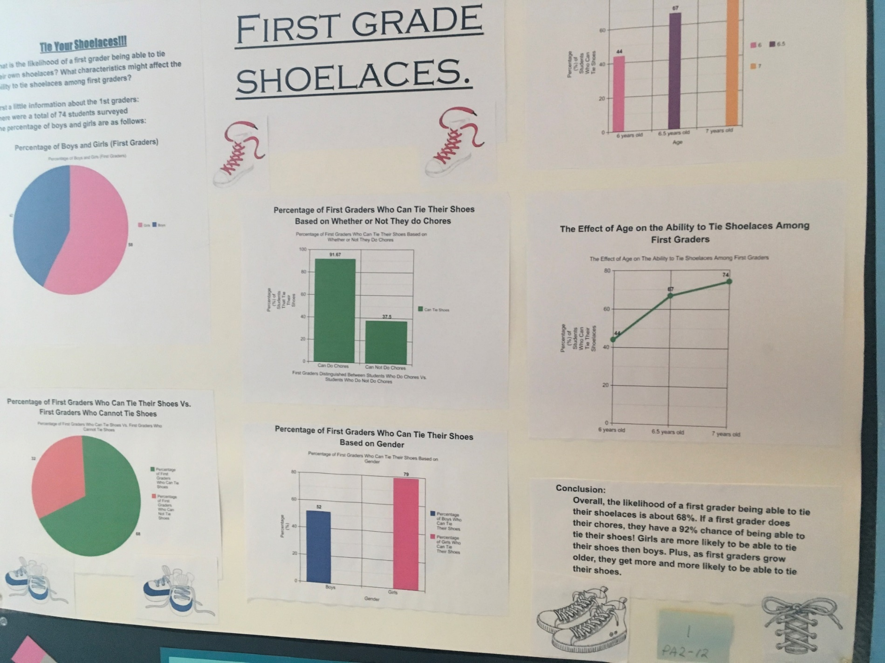
“First-Grade Shoelaces” (Grades 4-6)

Slide 15
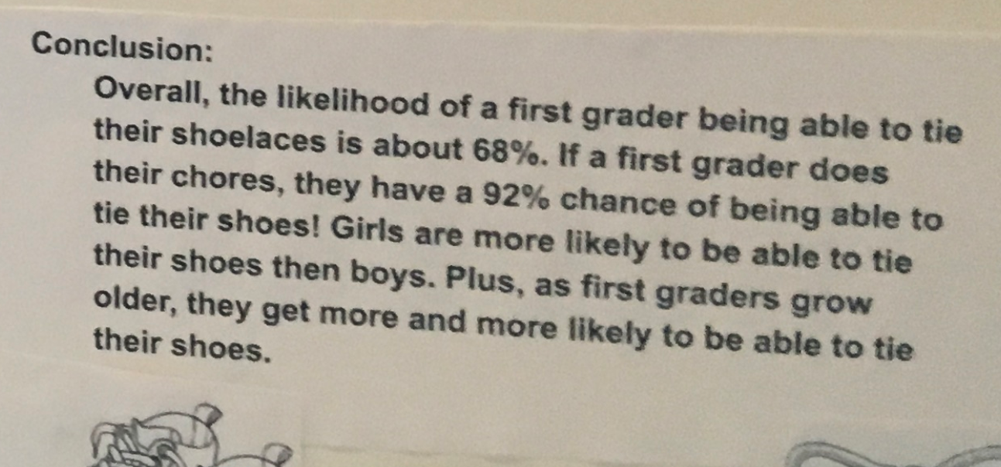
“First-Grade Shoelaces” (Grades 4-6) (results)

Slide 16
Next-Generation Science Standards
There are seven “cross-cutting” skills to support four core subject domains: Physical Science, Life Science, Earth and Space Science, and Engineering.
 | Cross-cutting skill
1 | Patterns
2 | Cause and Effect
3 | Scale, Proportion, and Quantity
4 | Systems and System Models
5 | Energy and Matter
6 | Structure and Function
7 | Stability and Change
Data Science analogue
Observations, Variables, and Pattern Matching
Causality
Measure Theory
Model Building
Systems Dynamics, Moments, and Entropy
Hierarchical, Structural, and Latent Variable Analysis
Variation, Complexity, and Interactions
16

Slide 17
Reproducibility (“academic” perspective)

Slide 18
Workflow (“professional perspective”) How does Disney do it?
Personas: Business
Information Worker
Excel, Powerpoint
Prepared BI reports
Light Statistics
Business Analyst
Excel, Powerpoint
COTS Reporting tool
Light Statistics
Data Analyst
Excel, Powerpoint
COTS Reporting tool
SQL

Slide 19
Workflow (“How does Disney do it?”)
Personas: Data Scientist
Data Scientist
Required: Python & SQL; Nice to have: Java, Scala
Machine Learning, Statistics, Deep Learning
Data wrangling skills
Distributed systems & algorithms
Data Sampling, approximate aggregations, extrapolation
Scientific Method - Notebooks
Data communication, visualization
Cloud services, Linux CLI
Bonus: NLP, image recognition

Slide 20
Workflow (“How does Disney do it?”)
Personas: Technical
Data Engineer
Distributed Systems, Stream Processing
Tools, Infrastructure, Frameworks, Services
Java, Scala, SQL, Python, R, Bash/Zsh
Linux, Git, DevOps, Cloud
Medium Stats
Medium ML/DL
Hadoop, Yarn, HDFS, ElasticSearch
Reporting Programmer Analyst COTS Reporting tool SQL

Slide 21

Workflow (“How does Disney do it?”)
Legend
IW - Info Worker
BA - Business Analyst
RA - Reporting Analyst
DA - Data Analyst
DS - Data Scientist
DE - Data Engineer
Current Process(s)
IW, BA, DS
IW
DS
Data Scientist
Discovery
Governance
Action
IW, BA, DE, DS
DE
DS, DE
IW
Data Science
Exploration
Governance
Extract & Load
Action
IW, BA, DE, DS
IW, BA, DA, DE DS, RA
IW, DE, BA
DE
DE
Governance
Extract & Load
Transform & Model
Analysis, Reporting,
Automation
Production
Action

Slide 22
Twitter, Podcasts, Tutorials
Twitter
#rstats
Podcasts
https://www.analyticsvidhya.com/blog/2018/01/10-data-science-machine-learning-ai-podcasts-must-listen/
Tutorials
http://tutorials.iq.harvard.edu/R/Rintro/Rintro.html
More references:
https://smithw.org/datajam

Slide 23
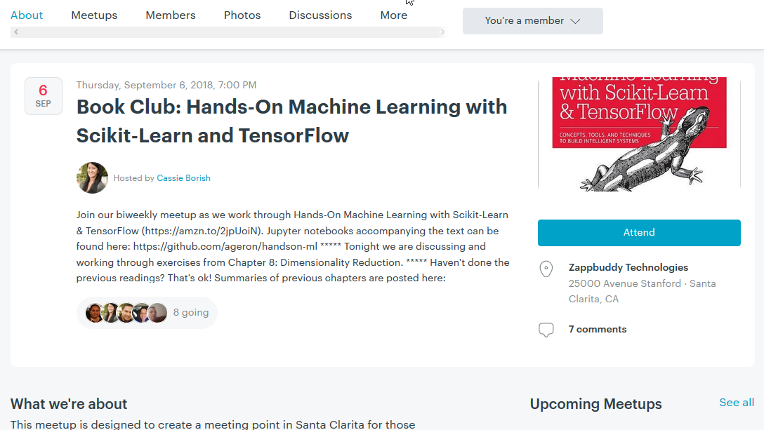

Slide 24
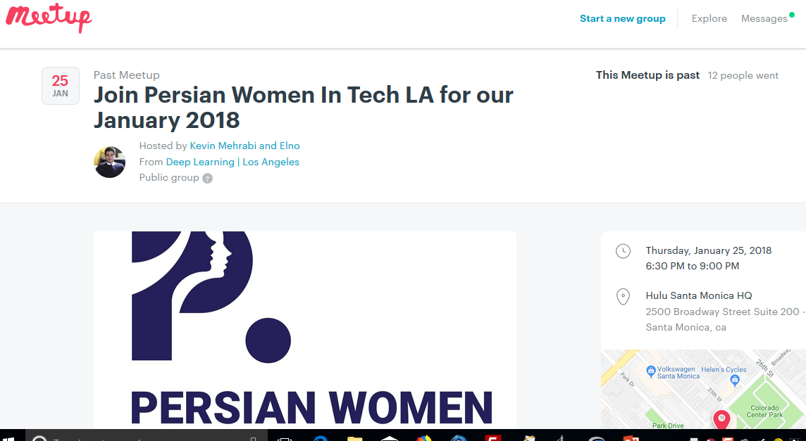

Slide 25
Conferences w/ videos (and convert to iTunes via VLC?)

Slide 26
Career Homework
TechFest (CSUN Career Center)
Marketed mostly to Eng/CompSci, but a data science learner goes…
Also, if a display sign doesn’t list “data science” (or whatever) on the sign, you ask about it…
Indeed.com
“data science intern”, “data science entry level”
E.g., 25 miles from CSUN
Do your homework from at least 20 job descriptions
What skills do I have? What skills don’t I have but I can get? What skills don’t I have that I don’t even know what the skill is?

Slide 27
Cloud Services
Free-tier
IBM Watson Cloud (you want the “no time restrictions” option)
https://console.bluemix.net/registration/free/
Amazon Web Services (you want the “non-expiring” offer)
https://aws.amazon.com/free/
Google Cloud (you want the “always free” option)
https://cloud.google.com/free/
Microsoft Azure (you want the “start free” option)
https://azure.microsoft.com/en-us/free/
CSUN too (https://www.csun.edu/it/ibm-cloud-services-csun)
Amazon certificate (https://laedc.org/2018/08/09/amazon-los-angeles-colleges-cloud/)
SMC (http://www.smc.edu/NewsRoom/Pages/Cloud-Computing-Certificate.aspx)
But keep in mind threats to both reproducibility and workflow

Slide 28
Canvas API Example
# do once
install.packages( “devtools” )
library( devtools )
install_github( “daranzolin/rcanvas” )
library( rcanvas )
set_canvas_token( “your-40-character-token-from-Account-Settings-here” )
set_canvas_domain( “https://canvas.csun.edu” )
# get course items
get_user_items( course_id = 12345, item = “assignments” )
get_user_items( course_id = 12345, item = “missing_submissions” )
# get course analytics
get_user_items( course_id = 12345, item = “activity” )
# upload a file
upload_course_file( course_id = 12345, file_name = “testfile.docx” )

Slide 29
Recent blog on LAPD arrests/crimes

Slide 30
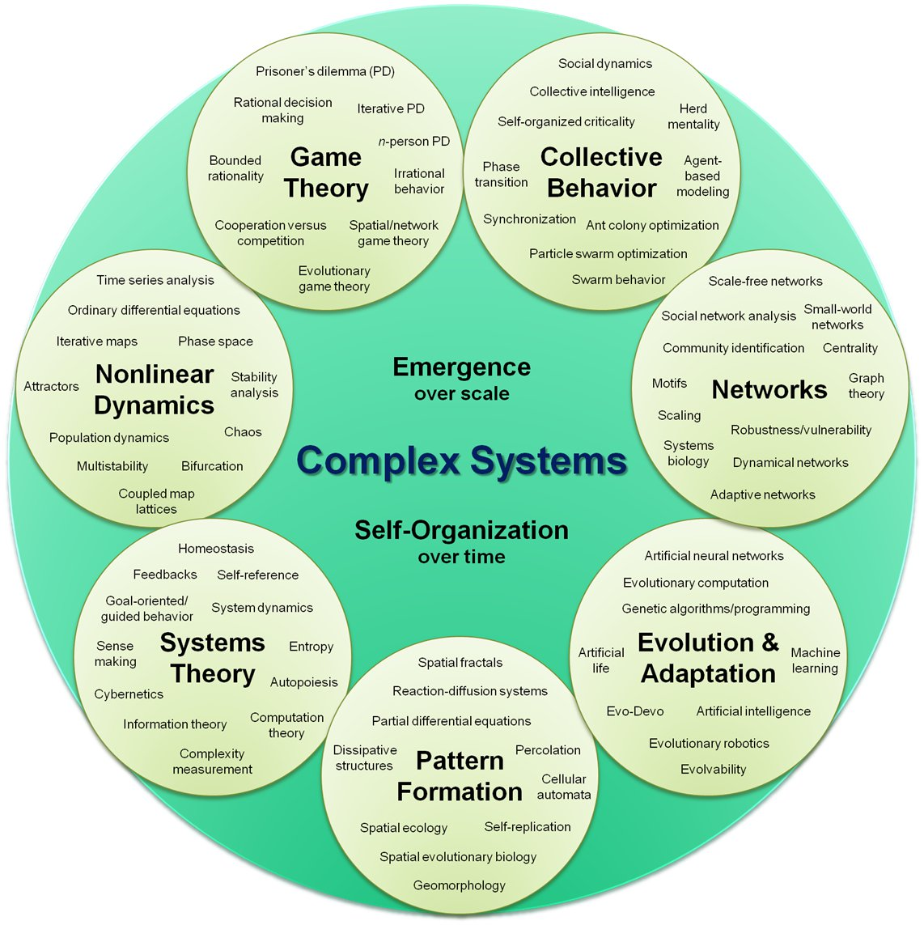
Macro-level (Complexity)

Slide 31
Micro-level (A New Language for conversations)
Student peers
Professional contacts
Most important—Professors
What kinds of research questions have you worked on?
What kinds of data have you used?
What kinds of analytical methods have you used?
What kinds of software tools have you used?
What would you like to learn in the near future?
How do you learn new things related to using data?

Slide 32
What do real world data science needs look like?

Slide 33
Data Science needs: Current Examples from the City of LA
Elected Officials
Affordable Housing Risk Scoring and Covent Risk Scoring
Downtown Transportation Analysis
Street Pavement Prioritization and Early Warning System
Property Values and Affordable and Low Income Housing
LAPD Recruitment Performance Dashboard
CAP tracking enhancements, dashboards, and integration with other Personnel systems
Attrition prediction tool
Homelessness Services Matcher

Slide 34
Data Science needs: Current Examples from the City of LA
Information Technology Agency
ServiceNow Analysis and Dashboard
Office of Finance
Call center operational improvements
Bill Collections
Revenue Forecasting
Department of Transportation
Projecting Parking Demand
Department of Cultural Affairs
Cultural Events Analytics, Neighborhood Arts Profile, and Cultural Desert Discovery

Slide 35
City of LA: Specific Examples
Downtown Transportation Analysis
Analysis of bicyclists and pedestrian use on Spring and Main both before and after Spring and Main Forward project. This will build on existing work from CSULA and LADOT. The Downtown configuration analysis for Project Downtown streets could show an ideal mix of various improvements and interventions. We hope to be able to project throughput for various streets downtown in different configurations.

Slide 36
City of LA: Specific Examples
LAPD Recruitment Performance Dashboard
LAPD Personnel recruiters’ main metric for success for recruiting candidates is the number of tests administered. However, there is limited visibility into which recruiters are testing the highest proportion of successful candidates, what strategies are most viable, or which geographic areas and events yield the best results. In preparation for anticipated surges in retirement, smarter recruiting is essential. A paradigm shift that is outcome-oriented will lead to greater accountability and flexibility as LAPD and Personnel strive to meet hiring goals. For this project, we wish to provide recruiters with new metrics of success.

Slide 37
Counterpoint
Hernandez, D., and Greenwald T. (August 11, 2018), “IBM Has a Dilemma”, Wall Street Journal.
Muller, J. (2018), The Tyranny of Metrics, Princeton University Press.
O’Neill, C. (2017), Weapons of Math Destruction: How Big Data Increases Inequity and Threatens Democracy, Broadway Books.
Pearl, J. (2018), The Book of Why: The New Science of Cause and Effect, Basic Books.
Tenner, E. (2018), The Efficiency Paradox: What Big Data Can’t Do, Alfred A. Knopf.

Slide 38
References
Automation vs. Analytics
Davenport, T. (2009), “Make Better Decisions”, Harvard Business Review, Nov. 87(11), p. 117-123.
Curriculum Guidelines for Undergraduate Programs in Data Science
https://www.stat.berkeley.edu/~nolan/Papers/Data.Science.Guidelines.16.9.25.pdf
Complex Systems chart
By Hiroki Sayama, D.Sc. - Created by Hiroki Sayama, D.Sc., Collective Dynamics of Complex Systems (CoCo) Research Group at Binghamton University, State University of New York, CC BY-SA 3.0, https://commons.wikimedia.org/w/index.php?curid=12191267

Slide 39
fin
Again: Are you a data science learner?
Questions?
Goodies

